Slide 1
Use case Assignment-1
By
MD AQUIB AZMI

Slide 2
Q. A man has took a shop in Rent near BTM Layout, Bangalore, not in the main road but as a local shop. The rent of the shop is 14000 per month. The man took the shop to sell fast food like - Biryani, Maggie, Egg Bhujia, Omlets, Chicken Kabab etc.
a. In the first 3 months he make a profit of around 100000, with a sales of around 300000.
b. In the 1st month he was selling veg food also, but he stopped after the 2nd month as it stock was not getting out.
c. After 4 – 5 months down the line the man is making a huge loss in his investment. He has a due of 2 months to pay the rent.
d. The sale has drastically gone down and he is thinking to close the shop.
e. The Man is very lazy in working hard and also very poor in any other investment.
How will you tackle a situation of this kind? Write a solution to this kind of problem. Give a Fact-full answer by understanding the critical problems.

Slide 3
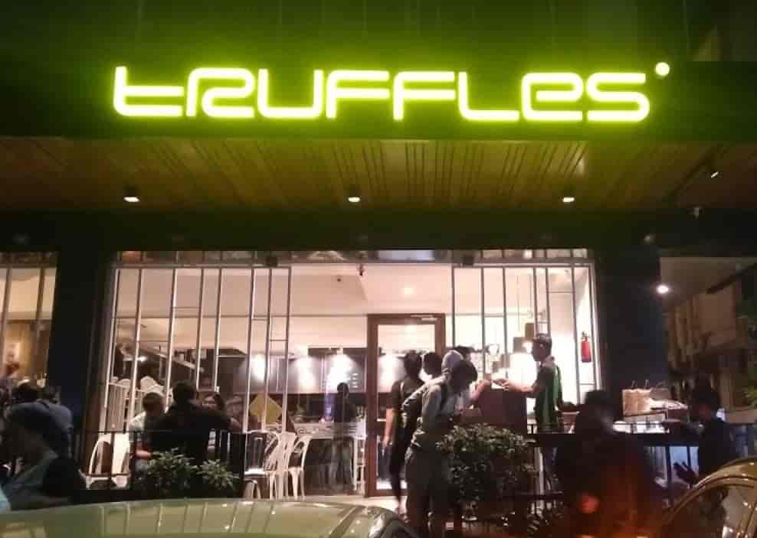
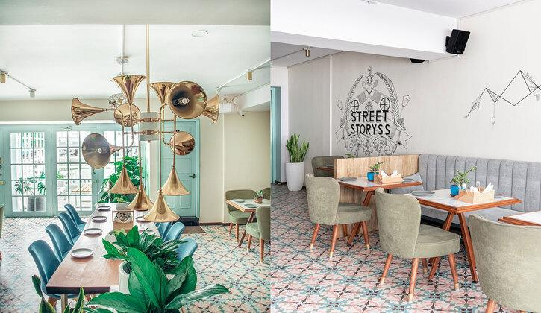
BTM LAYOUT BENGALURU
There are a lots of fast food restaurant in BTM layout bengaluru which are pretty good like Truffle, Btm fast food, Foodmode and so on.

Slide 4
How to tackle the situation
1. KNOW THE COMPETITION To overcome the competition at their own game, you must know them well. Visit their restaurants and find out how tasteful their ambiance is, how their food tastes, and how good their service standards are. You can compare their food quality and service standards with yours, and then take the necessary action. Also, to know their marketing efforts, subscribe to their email list, and follow their brands on social media. This will help you formulate your marketing strategies.
2.PRICING THE MENU Your Menu is the most powerful tools.Keep a tab on your highest selling and low selling items. If you think your customers would be willing to pay for your star items, you can increase their prices or push them more, while you can decrease the number of dogs in your menu.

Slide 5
3. SELL YOU UNIQUE ITEM
Once you know your competition well, you can identify what it is you offer that is unique or special. If you do not have a unique selling proposition that separates you from your competition, you need to establish it to stay in business.
4. STAFF SELECTION
In the hospitality business, you can never be polite enough. And, that’s what your staff needs to learn. Make sure your staff, right from the valet to front doorman, waitpersons, and hosts, are polite and courteous. Take up weekly meetings with your staff to reiterate the rules.
5. SELL ONLINE YOUR FOOD
Today everything is online. Registered your restaurant on food delivery company like zomato and swiggy because a lots of people are making order online. This will grow your sell in a massive way.

Slide 6
Solution to the above Problem
1. We have to see what was the prospective that the person making a profit of around 1 lakh and what type of mistake he is doing in the next four-five month.
2. He should start selling online through food delivery app.
3. He should add some more item in his Menu and reduce his staff expenses.
4. He should giveup his laziness because this is the main factor by which a person can never get success if he show laziness in his work.

